Slide 1
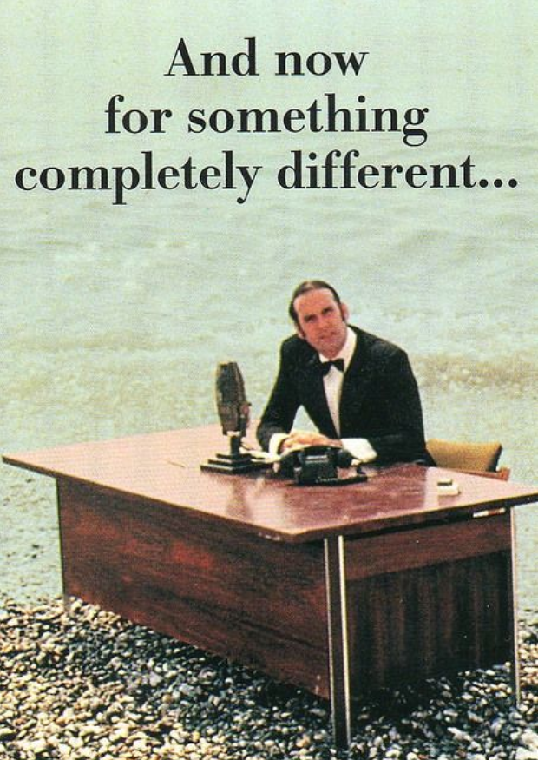
To the rescue of Copenhagen Interpretation
Igor Salom
Institute of Physics, Belgrade
arXiv:1809.01746 [quant-ph]

Slide 2
All the fuss…
D. Frauchiger and R. Renner, Single-world interpretations of quantum theory cannot be self-consistent, arXiv:1604.07422
Replies ensued:
V. Baumann, A. Hansen and S. Wolf,
arXiv:1611.0111
V. Baumann and S. Wolf,
arXiv:1710.07212
A. Sudbery,
arXiv:1608.05873
MW is ok, so is “mechanical-collapse”, but nothing else: “subjective-collapse” is inconsistent!
DBB single-world variant is also ok!

Slide 3
But what with the “standard” QM?!
Standard QM = ?
- If anything, it is the Copenhagen interpretation
But what is the Copenhagen interpretation?
Whatever is, it certainly assumes:
unitary evolution of the system wave-function in between of the measurements
wave-function collapses upon the measurement
Nothing compatible is allowed, according to these authors, even Rovelli’s, Qbism and Brukner are dubious (possible “scientific contradiction”)

Slide 4
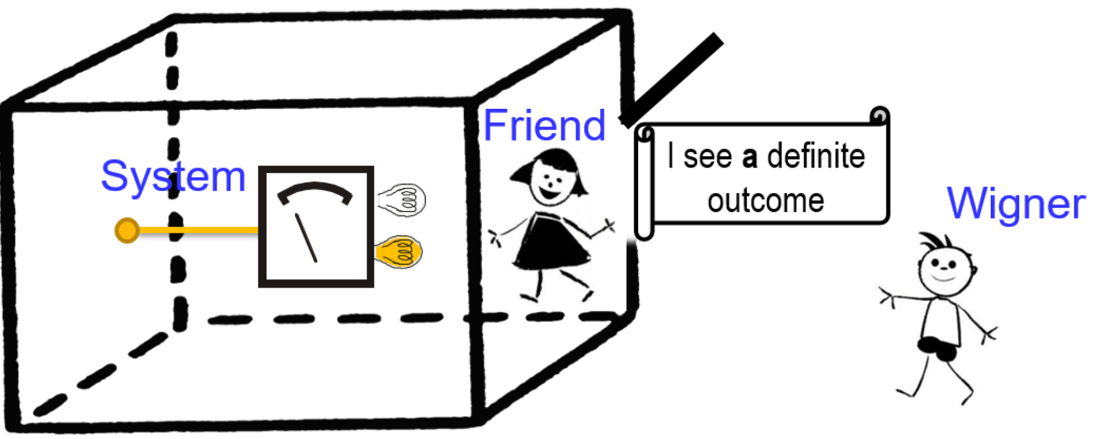
So what is the argument?
It all revolves around (extended) Wigner’s friend gedanken experiment:
One is actually enough
Illustrations are courtesy of Č. Brukner

Slide 5
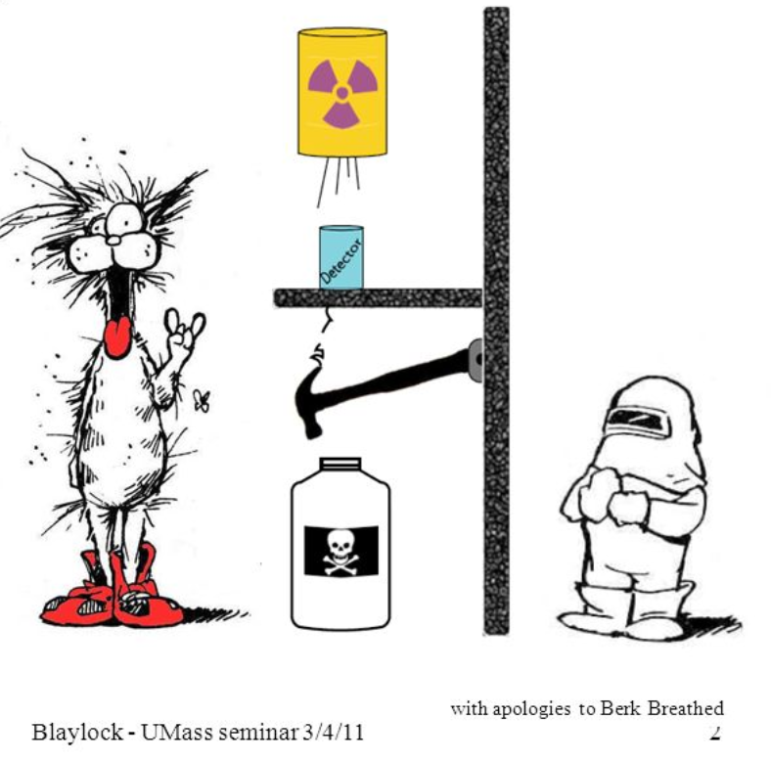
Who’s the Wigner’s friend?
Essentially, (s)he is evolved (in every sense) Schrodinger’s cat in a less violent setup…

Slide 6
The paradox in a nutshell
Can he get W- outcome? Who is right?
A spin ½ particle (system) and the friend are enclosed in an information-proof box, Wigner is outside
Spin is aligned with the x+ axis
but the friend measures it along z direction, and then:
The friend: the state is either or
Wigner: the state must be
Wigner then measures in basis (in principle he can):

Slide 7
Who’s right?
Different predictions (formalisms)
To summarize these papers:
Wigner, if no collapse (relative state, MW, DBB)
The friend, if collapse is objective-mechanical (GRW, Penrose)
Contradiction, if collapse is “subjective” (QBism, Rovelli???)
This is “scientific contradiction” since the friend can communicate his prediction:
Thus, we must dismiss option 3!
But where is the “standard QM”, i.e./e.g. Copenhagen interpretation, with postulates I and II?!

Slide 8
We need a closer inspection!
All agree – everything is fine, no paradoxes, experiment even practically feasible!
Begin with a simpler case of a “photon friend”!
At t₀:
At t₁ – spin measurement:
At t₂ – interference measurement in basis:
…obviously yields W+ outcome.
At t₃ – hypothetical H/V measurement:
or

Slide 9
Now, increase “friend” complexity
If the “friend” is a few photons instead of one:
Nothing is expected to change!
As we further increase the complexity/size, mechanical-collapse models are expected to diverge in predictions (i.e. to predict nonzero W- probability), certainly long before a human friend
Such models imply new physics and don’t comply with postulates I and II => we put them aside
Otherwise, nothing should change, still no W- !

Slide 10
Computing device - friend
Computing: algorithm that performs a "calculation", which is in turn a "process that transforms one or more inputs into one or more results".
At which point the paradox then arises!?
Bauman at all: "thinking (or computing) entity“, capable to calculate W- probability?
Only objective input – was there any objective measurement = always “true” => constant output
=> “computing entity” per se, does not introduce any paradox!

Slide 11
Human measurement device?
If there is no new physics, a human device must yield the same “no W-” result.
There is nothing “objectively” paradoxical
Yet, the paradox is there, but ONLY when we consider what the “human device friend” SUBJECTIVELY experiences!
If he experiences a single outcome, then he is entitled to apply the collapse postulate!

Slide 12
Human friend, Wigner perspective
Initially:
Spin measurement at t₁:
At t₂ the state is:
Wigner performs interference measurement in basis
and obtains W+ with certainty.
At some t₃ friend “decoheres” into either
or
Unitarity respecting interpretations find: 1) W+; 2) friend will remember seeing single outcome at t₁ decided at t₃!

Slide 13
Human friend, friend’s perspective
Interference measurement did not alter the state
Friend retells of a single outcome and concludes there must have been a collapse
He is confused by “no W-” outcome!
His confusion in predicted by unitarity of QM!!!
His memory was decided at t₃
Paradox: what did he perceive in the other, forgotten subjective experience between t₁ and t₂!?
Perceiving a single outcome about spin at t₁ is contradicting with “no W-” (e.g. collapse now, sharp values of non-commuting observables)

Slide 14
You must pick!
Available (standard) explanations:
Mechanical collapse (“yes W-“, many sub-variants)
Many-world (no collapse, two friends see two outcomes)
DBB (no collapse, “MW with pointer”)
QBist (agnostic, QM cannot “pierce other’s experience”)
Rovelli, Brukner (“no facts of the world”)
Brukner claims the only way to save CI, even formulates a no-go theorem
Yet…

Slide 15
Our proposal(s)
There is simply no friend’s subjective experience in between t₁ and t₂, from Wigner’s point!
Indeed, there is no any trace in the universe that such experience existed:
the one recounted by the friend was decided at t₃
if there was any memory before, it would have been erased
if he signaled the result, it would have collapsed the w.f.
Why insisting on existence of something that left no trace/proof of existence?!
Especially when it causes contradictions!

Slide 16
No subjective experience at t₁
Option overlooked due to tacit assumptions:
subjective perception is a mere product of brain functioning
experience must also emerge from a "potential" state of a brain
None of these is generally accepted in cognitive science, even less proved (2. is denied even by DBB)
Only correlation of the subj. experience and brain functioning is beyond doubt
There is no any paradox without these assumptions!

Slide 17
Then, what the friend perceives?!
Multiple possible answers:
“collapse causes consciousness”: the friend’s consciousness only becomes existent at t3 (from Wigner’s viewpoint). At that moment the friends “lives through” all events from t₀ to t₃.
“no objective consciousness”: there is never friend’s subj. experience for Wigner. Related to “other minds” problem.
“perception of future”: Wigner can attribute concurrent experience to the friend, only of outcome defined at future moment t₃. Yet, apparently no contradictions.
Variants 1 and 3 assume drastic temporal relativity of the subjective experience. Possibly, they are the same!

Slide 18
Subjective collapse is subjective!
Thus, all three proposed explanations can be seen as “sub-interpretations” of CI (with subjective collapse)
Stick to CI postulates and everything is fine:
The friend must not attribute collapse to prediction of Wigner’s outcomes!
He can apply collapse when predicting his experiences!
This way – no conflict at all, all predictions correct
Avoiding “double” experiences
There are “facts of the world” – union of subjectively perceived outcomes.

Slide 19
Possible objections
What If the friend communicates with Wigner while in the box?
- no problem in any of the sub-interpretations
Whose experiment it is and whose perspective is appropriate?
actually, there is a symmetry thanks to the “other minds” problem
movie analogy
For more details, read the arXiv paper

Slide 20
Comparison with other views
Same objective predictions (formalism) as with MW, QBism, DBB, Rovelli, Brukner, CI,...
Differences:
Rovelli/Brukner: no flip in friend’s experience, there are “facts of the world”
Qbism: “no objective consciousness” view is similar, here a feature of subj. experience, not inability of QM
MW: there is NO need to keep all terms of the w.f. forever – w.f. is only tool for calculating probability of next reality, and does not have ontic existence per se (e.g. terms that are irrelevant do not exist).
Wheeler: similarities with “each elementary quantum phenomenon is an elementary act of fact creation” and “the observations of all the participators, past, present and future, join together to define what we call reality”

Slide 21
Conclusions
The root of WF paradox is inseparable from the problem of subj. experience (motive for Wigner himself)
Importance of the “final decoherence” moment t₃
This led to CI with subjective collapse and 3 sub-interpretations: "collapse causes consciousness", "no objective consciousness" and "perception of future", while keeping “facts of the world”.

Slide 22
Conclusions
Proposed views depend on assumptions on consciousness, but so do all of the interpretations!
WF relates interpretations of QM and interpretations of consciousness:
MW ↔ “strong emergent hypothesis”
DBB ↔ “week emergent hypothesis”
Rovelli/Brukner ↔ “??? emergent hypothesis”
QBism ↔ agnostic in principle
“collapse causes consciousness”, “perception of future” ↔ time relative (agnostic/dualistic)
“no objective consciousness” ↔ extremely subjective
No need for actual experiment, great theoretical importance!
Relying on “other minds” problem

Slide 23
Thank you!

